Slide 1
Select SQL Query

Slide 2
SELECT
SELECT is used to retrieve rows selected from one or more tables
The DISTINCT clause after SELECT eliminates duplicate rows from the result set.
DISTINCT works across all columns to deliver the results, not individual columns

Slide 3
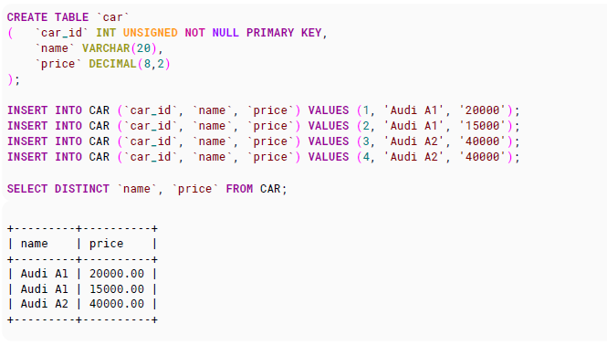
Example for Distinct Clause

Slide 4
SELECT
SELECT all columns (*)
SELECT * FROM stack;
SELECT by column name
SELECT id FROM stack;

Slide 5
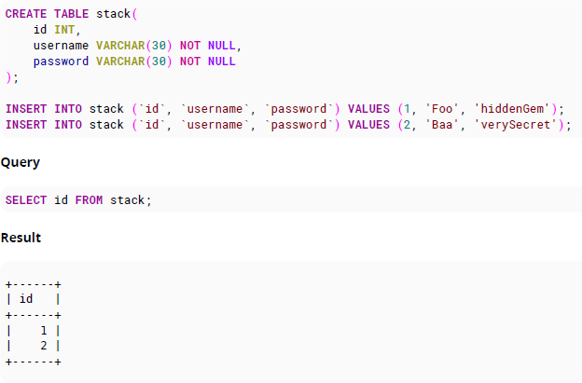
EXAMPLE

Slide 6

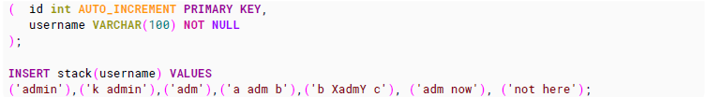
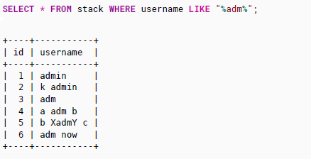
SELECT with LIKE (%)
"adm" anywhere:

Slide 7
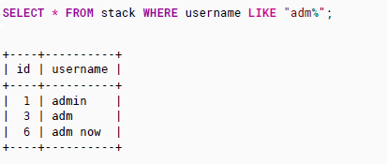
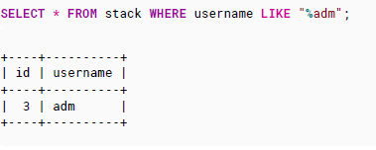
SELECT with LIKE (%) Cont…
Begins with "adm":
Ends with "adm":

Slide 8
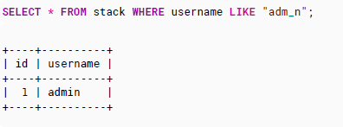
SELECT with LIKE (%) Cont…
Just as the % character in a LIKE clause matches any number of characters, the _ character matches just one character. For example

Slide 9
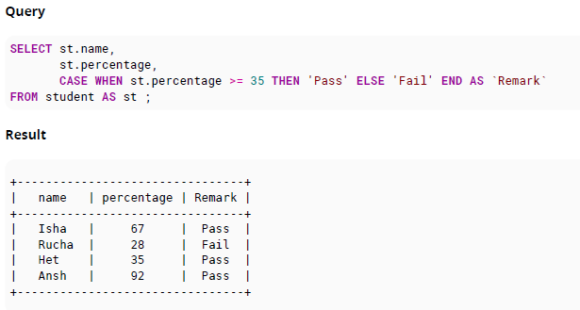
SELECT with CASE or IF

Slide 10
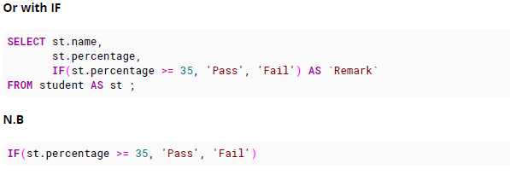
SELECT with CASE or IF Cont…

Slide 11

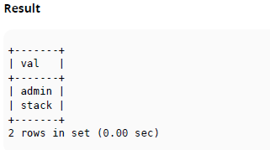
SELECT with Alias (AS)
SQL aliases are used to temporarily rename a table or a column. They are generally used to improve readability

Slide 12
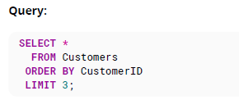
SELECT with a LIMIT clause
Best Practice Always use ORDER BY when using LIMIT; otherwise the rows you will get will be unpredictable

Slide 13
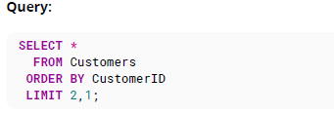
SELECT with a LIMIT clause
Explanation:
When a LIMIT clause contains two numbers, it is interpreted as LIMIT offset,count. So, in this example the query skips two records and returns one.
The values in LIMIT clauses must be constants; they may not be column values.

Slide 14
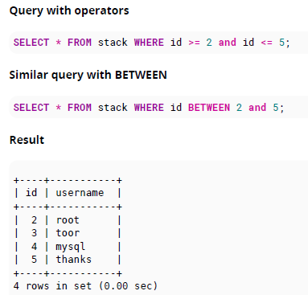
SELECT with BETWEEN
You can use BETWEEN clause to replace a combination of "greater than equal AND less than equal" conditions

Slide 15
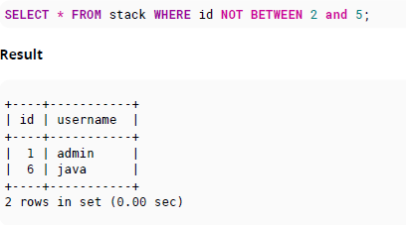
SELECT with BETWEEN cont…
If you want to use the negative you can use NOT. For example :

Slide 16
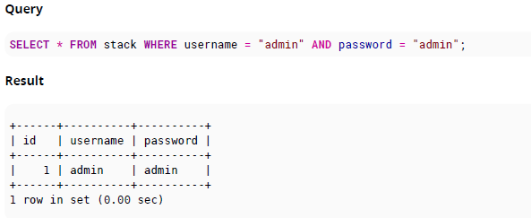
SELECT with WHERE

